Slide 1
CMU Security Specialist Course Team Project Phase 1
Six senses Team 6
Seongju Moon (L)
Kyungnam Bae (E)
Jinmo Kim (A)
Jeonghwan Ahn (S)
* Byungchul Park (C)

Slide 2
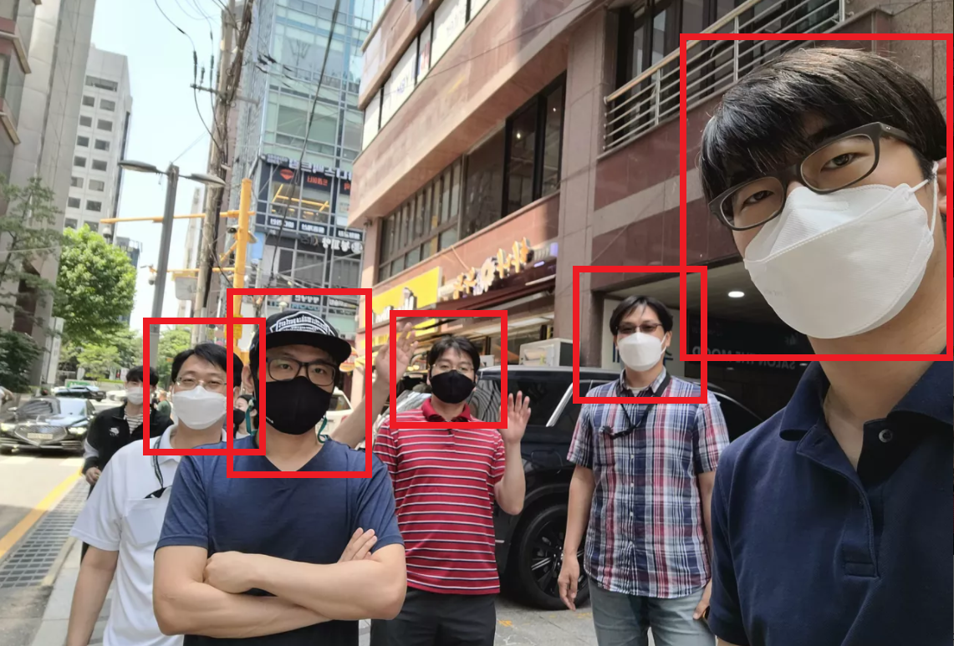
Mr. Bae
Mr. Kim
Mr. Park
Mr. Moon
Mr. Ahn

Slide 3
Define security goal
Define assets to protect
Do threat modeling
Do risk assessment to prioritize items
Define security requirements
Derive mitigations
Construct architecture
Implement the mitigations
Verify the mitigations

Slide 4
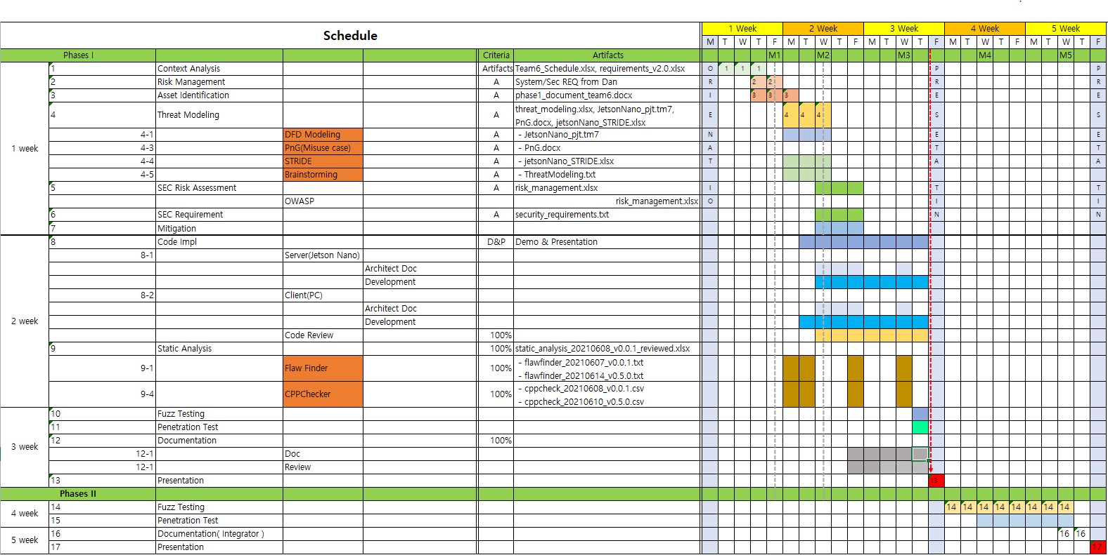

Slide 5
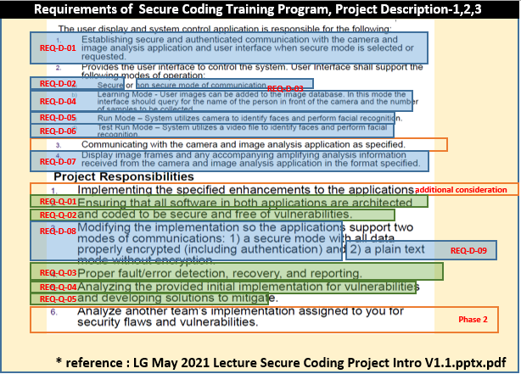

Slide 6
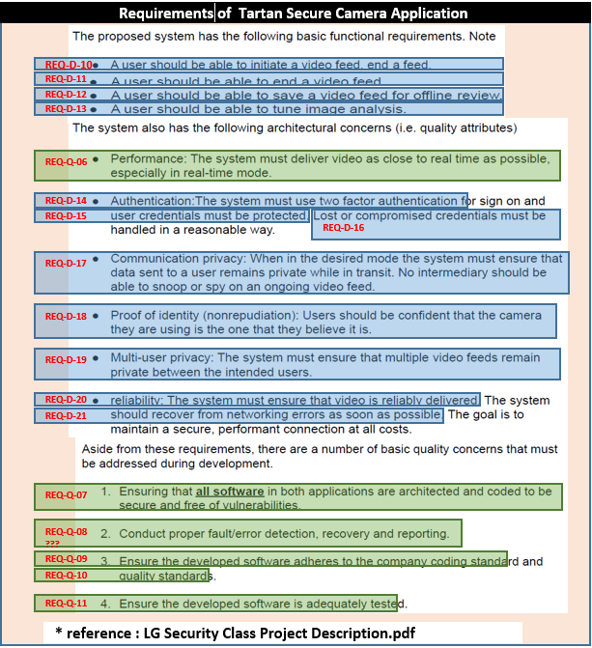

Slide 7
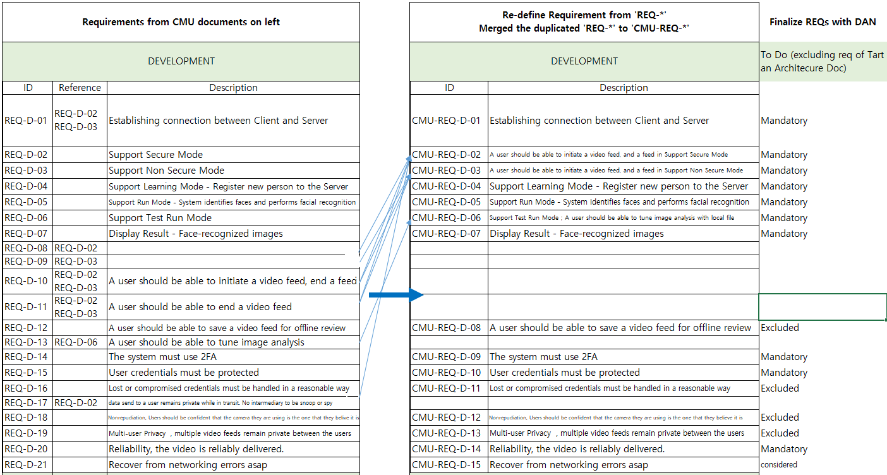

Slide 8
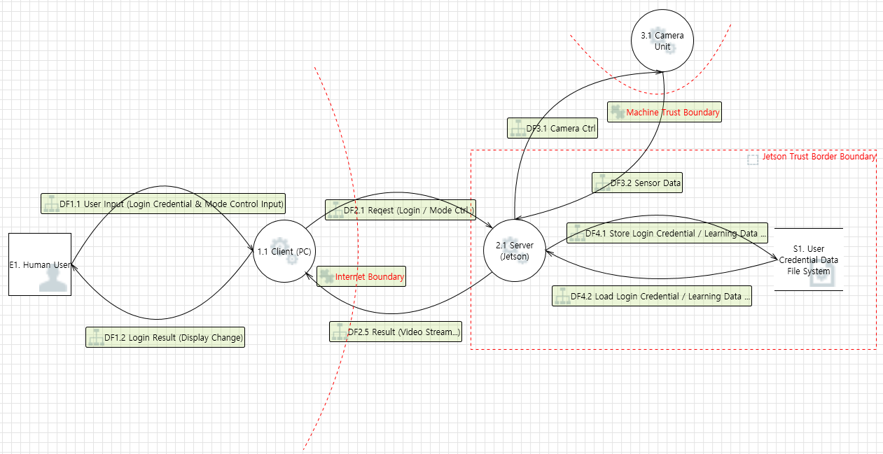

Slide 9
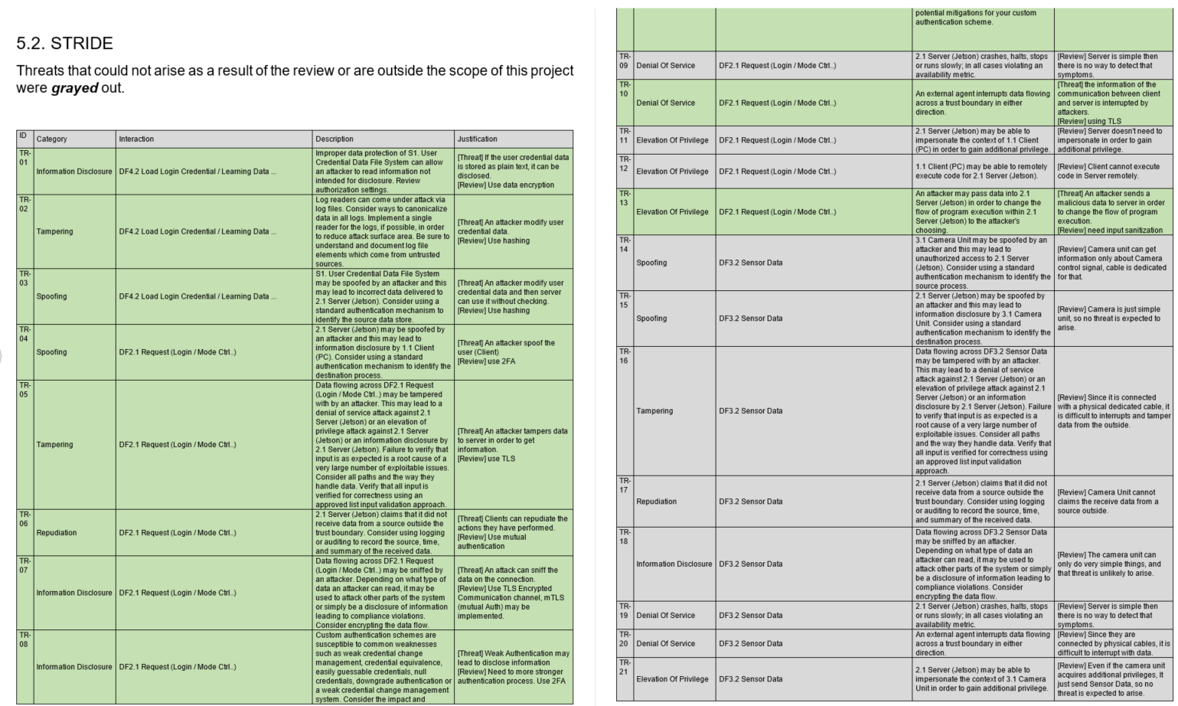

Slide 10
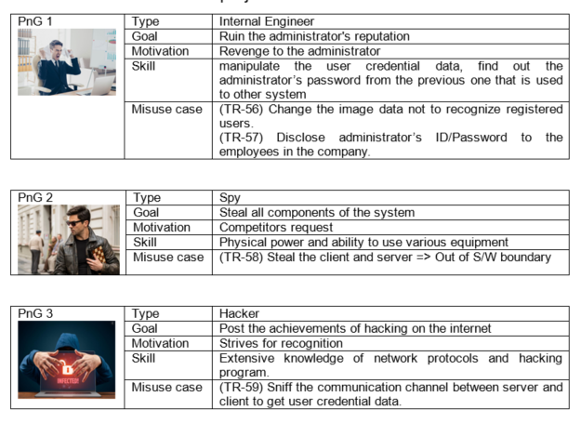

Slide 11
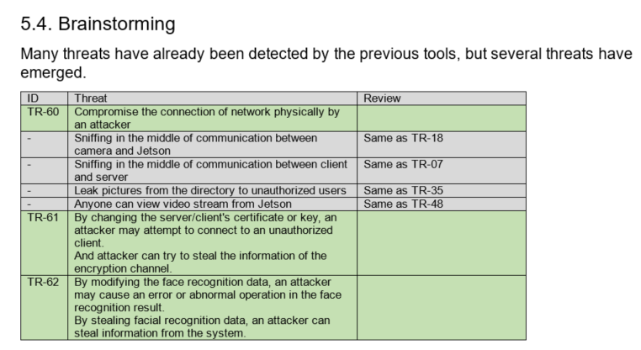

Slide 12
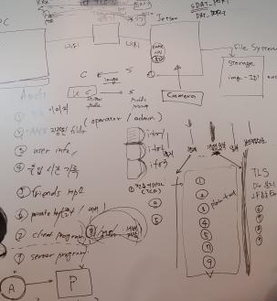

Slide 13
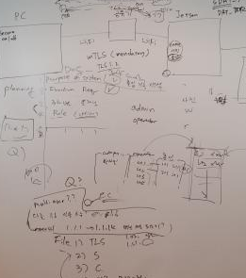

Slide 14
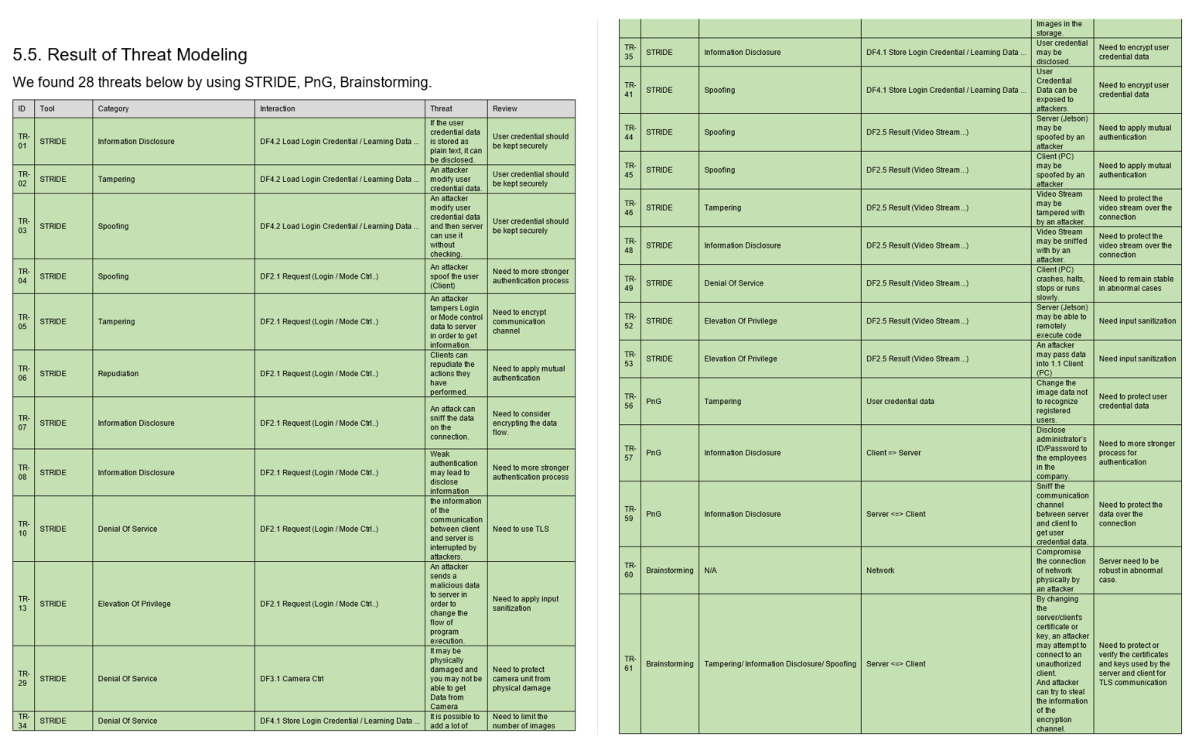

Slide 15
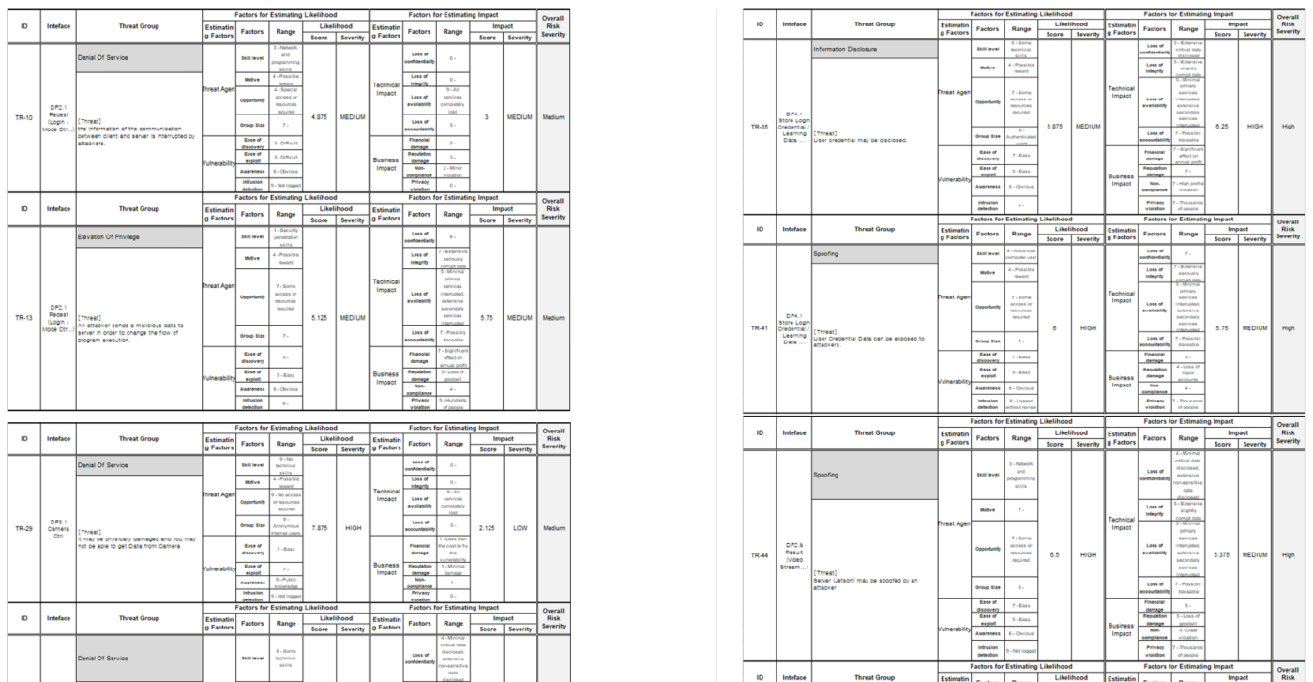

Slide 16
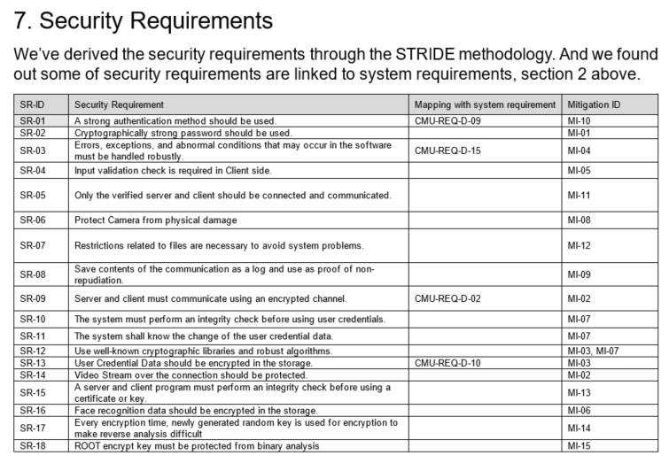

Slide 17
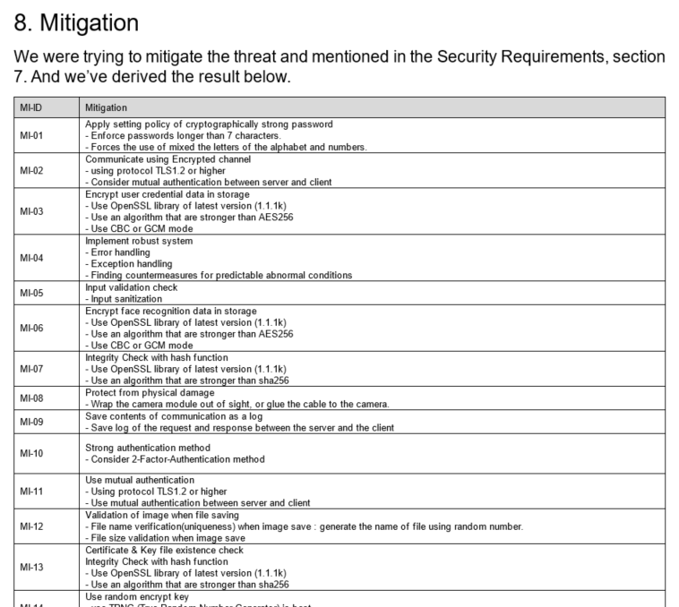

Slide 18
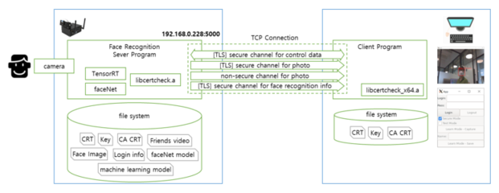

Slide 19
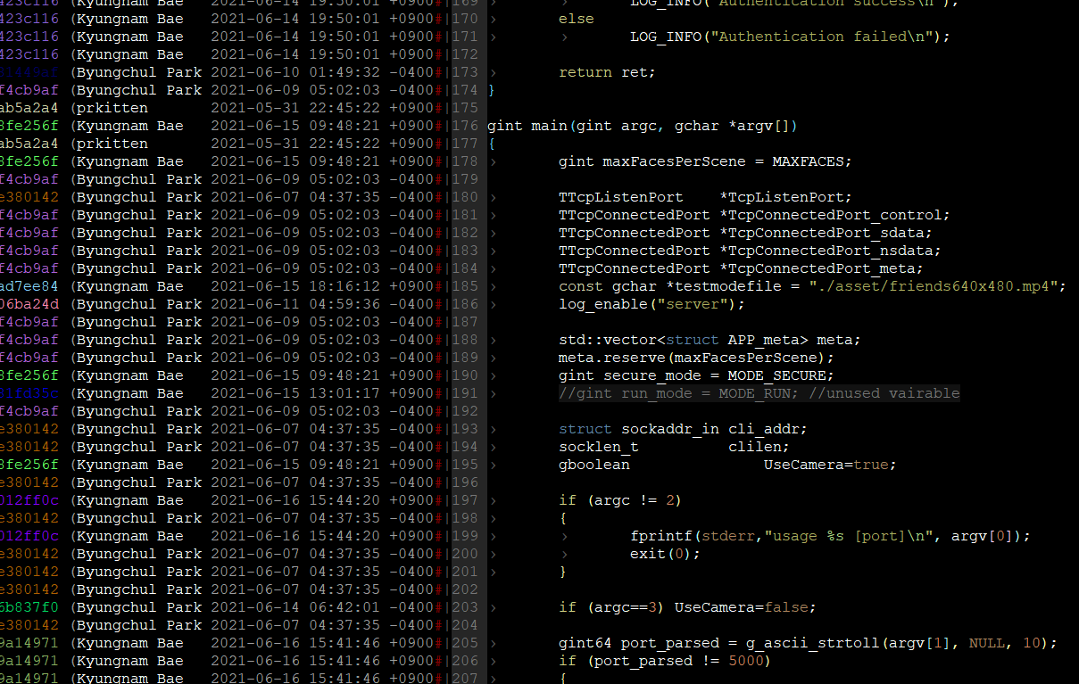

Slide 20
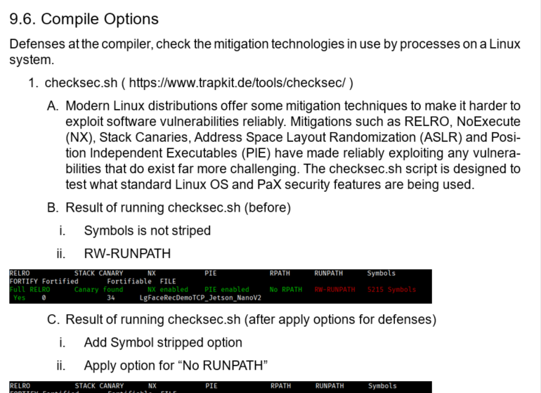

Slide 21
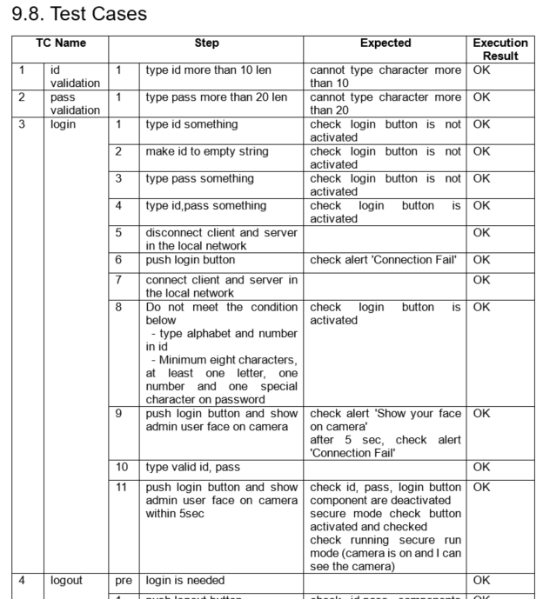

Slide 22
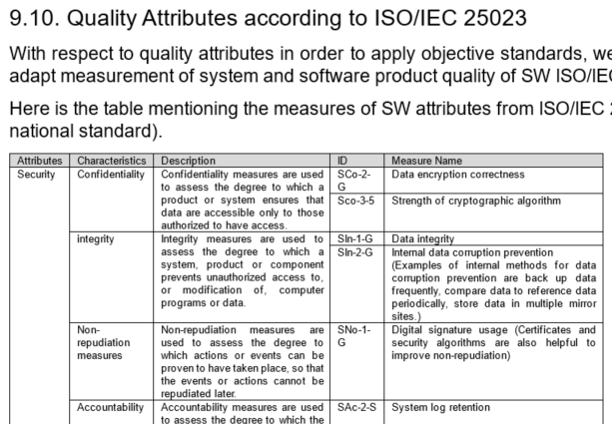

Slide 23
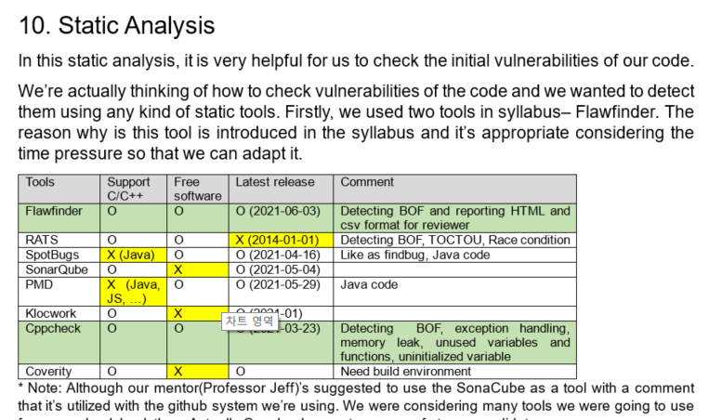

Slide 24
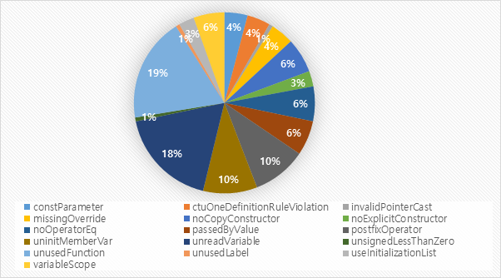

Slide 25
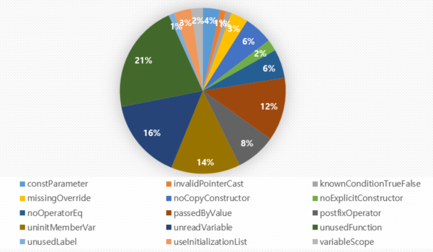

Slide 26
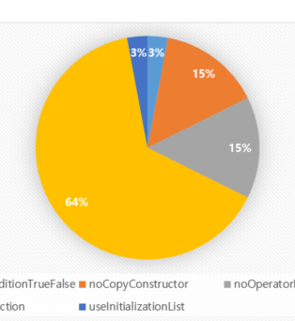

Slide 27
Define security goal
Define assets to protect
Do threat modeling
Do risk assessment to prioritize items
Define security requirements
Derive mitigations
Construct architecture
Implement the mitigations
Verify the mitigations

Slide 28
Define security goal
“ Protect the user privacy information in our system. ”

Slide 29
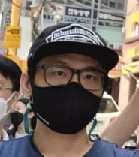
Define assets to protect + Do threat modeling
+ name

Slide 30
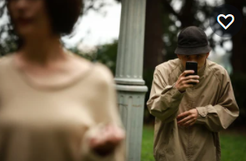
Define assets to protect + Do threat modeling
+ name
#privacy #stalker
#name

Slide 31
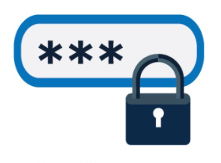
Define assets to protect + Do threat modeling
+ name
#privacy #stalker
#name
#authentication #2FA
#face #recognition

Slide 32
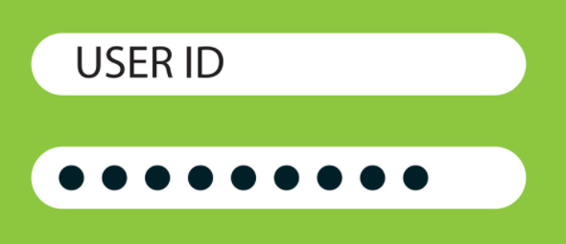
Define assets to protect + Do threat modeling

Slide 33
Define assets to protect + Do threat modeling
#authentication
#login #password

Slide 34
Define assets to protect + Do threat modeling
#authentication
#login #password
#privacy

Slide 35

Define assets to protect + Do threat modeling

Slide 36
Define assets to protect + Do threat modeling
#privacy
#authentication

Slide 37
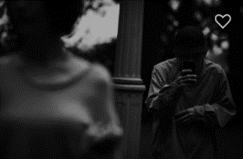
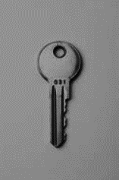
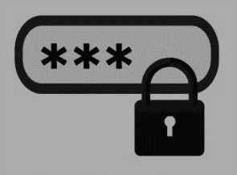
Define assets to protect + Do threat modeling
IMPORTANT ASSUMPTION
The root of trust is trustworthy,
which is the way to keep the KEYs secure.
#privacy
#authentication

Slide 38
Derive mitigations
Introduce login system
Force users to use strong password
Apply 2FA (what you know + what you are)
Separate meta data from image on network
Encrypt the image + name in the storage
Use verified crypto algorithm (AES256-CBC)
Use a random file name in the storage
Use TLS in network communication
+ name

Slide 39
Derive mitigations
Introduce login system
Force users to use strong password
Apply 2FA (what you know + what you are)
Separate meta data from image on network
Encrypt the image + name in the storage
Use verified crypto algorithm (AES256-CBC)
Use a random file name in the storage
Use TLS in network communication
+ name

Slide 40
Derive mitigations
Introduce login system
Force users to use strong password
Apply 2FA (what you know + what you are)
Separate meta data from image on network
Encrypt the image + name in the storage
Use verified crypto algorithm (AES256-CBC)
Use a random file name in the storage
Use TLS in network communication
+ name

Slide 41
Derive mitigations
Introduce login system
Force users to use strong password
Apply 2FA (what you know + what you are)
Separate meta data from image on network
Encrypt the image + name in the storage
Use verified crypto algorithm (AES256-CBC)
Use a random file name in the storage
Use TLS in network communication
+ name

Slide 42
Derive mitigations
Introduce login system
Force users to use strong password
Apply 2FA (what you know + what you are)
Separate meta data from image on network
Encrypt the image + name in the storage
Use verified crypto algorithm (AES256-CBC)
Use a random file name in the storage
Use TLS in network communication
+ name

Slide 43
Derive mitigations
Introduce login system
Force users to use strong password
Apply 2FA (what you know + what you are)
Separate meta data from image on network
Encrypt the image + name in the storage
Use verified crypto algorithm (AES256-CBC)
Use a random file name in the storage
Use TLS in network communication
+ name

Slide 44
Derive mitigations
Introduce login system
Force users to use strong password
Apply 2FA (what you know + what you are)
Separate meta data from image on network
Encrypt the image + name in the storage
Use verified crypto algorithm (AES256-CBC)
Use a random file name in the storage
Use TLS in network communication
+ name

Slide 45
Derive mitigations
Introduce login system
Force users to use strong password
Apply 2FA (what you know + what you are)
Separate meta data from image on network
Encrypt the image + name in the storage
Use verified crypto algorithm (AES256-CBC)
Use a random file name in the storage
Use TLS in network communication
+ name

Slide 46
Derive mitigations
Introduce login system
Force users to use strong password
Apply 2FA (what you know + what you are)
Separate meta data from image on network
Encrypt the image + name in the storage
Use verified crypto algorithm (AES256-CBC)
Use a random file name in the storage
Use TLS in network communication
+ name

Slide 47
Derive mitigations
Encrypt the hashed credential in the storage
Use TLS in network communication

Slide 48
Derive mitigations
Encrypt the hashed credential in the storage
Use TLS in network communication

Slide 49
Derive mitigations
Encrypt the hashed credential in the storage
Use TLS in network communication

Slide 50
Derive mitigations
Embed the root key into code obfuscated
Use TLS in network communication

Slide 51
Derive mitigations
Embed the root key into code obfuscated
Use TLS in network communication

Slide 52
Derive mitigations
Embed the root key into code obfuscated
Use TLS in network communication

Slide 53
Derive mitigations
Introduce login system
Force users to use strong password
Encrypt the hashed credential in the storage
Apply 2FA (what you know + what you are)
Separate meta data from image on network
Encrypt the image + name in the storage
Use verified crypto algorithm (AES256-CBC)
Embed the root key into code obfuscated
Use a random file name in the storage
Use TLS in network communication

Slide 54
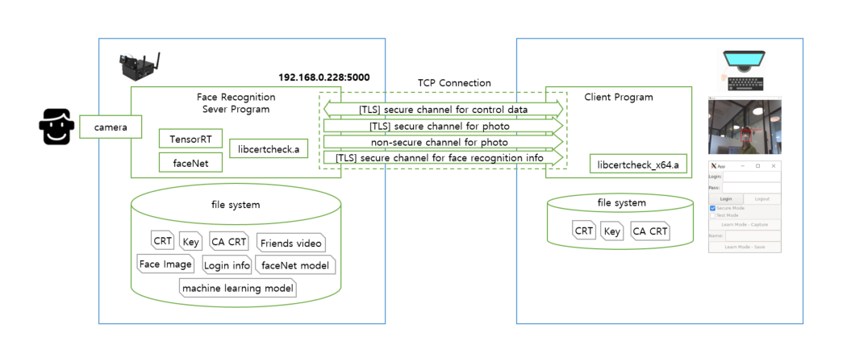
Construct architecture

Slide 55
Construct architecture
.
└── source
├── client
│ └── src
├── common
│ ├── keys
│ │ ├── ca
│ │ ├── client
│ │ └── server
│ └── libs
│ └── libcertcheck
│
└── server
├── facenetModels
├── imgs
├── mtCNNModels
├── src
└── trt_l2norm_helper
// client source codes
// self signed root certificate
// CA signed certificate & Private key for client
// CA signed certificate & Private key for server
// crypto library to support crypto API and to verify the integrity of keys.
// the root key for the crypto API are included as a string with obfuscated.
// the path of faceNet models
// the path of the photo registered with name. the filename and contents are encrypted
// the path of machine learning model in MTCNN_FaceDetection_TensorRT
// server source codes
// TensorRT L2-Norm Helper

Slide 56
Construct architecture
secure
run
secure
test run
Client State Diagram
On starting program
learn
init
logout
non secure
run
non secure
test run
Can be reached
from any state
by logout button

Slide 57
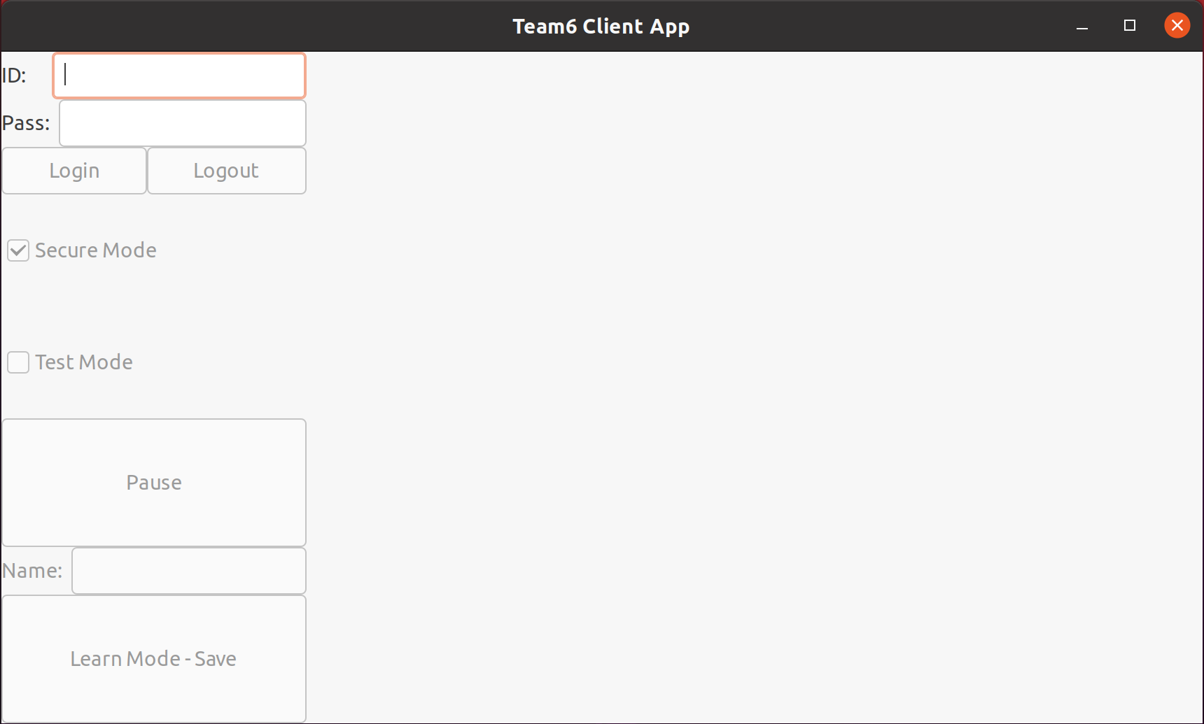
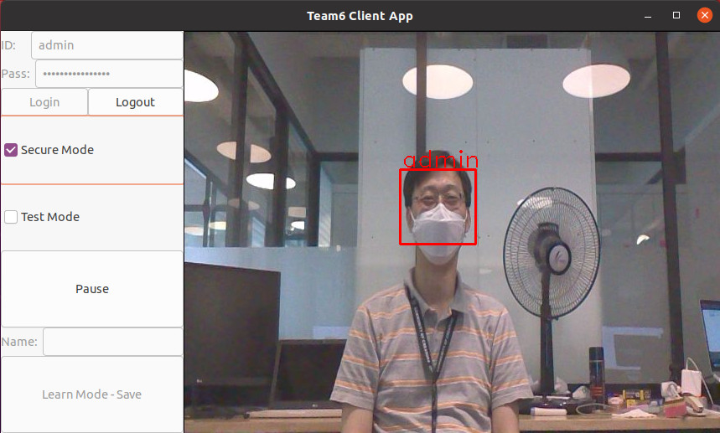
Construct architecture

Slide 58
Construct architecture
Let me show you demo clip..

